Slide 1

A Cluster-Based Approach to Fitting Regression Models
By Austin Hadamuscin, James Hawkins, Tomiwa Omotesho, Deep Sagar Karki

Slide 2
Objective
Determine the most important variables for improving average lifespan
Determine whether there are better ways to group countries besides development statues
Build a regression model to show the effect a variable can have on healthy life expectancy

Slide 3
Data
World Health Organization (WHO)
2014
180 countries
Missing Values Imputed with k-NN
Leave-One-Out Cross Validation

Slide 4
variables
Diptheria - diphtheria tetanus toxoid and pertussis (DTP3) immunization coverage among 1-year-olds (%)
BMI - Mean body mass index trends among adults, crude (kg/m²)
Alcohol - Recorded alcohol consumption (ages 15+) per capita in liters of pure alcohol
Adult.Mortality - mortality rate per 1000 people aged 15-60
HepB - Hepatitis B (HepB3) immunization coverage among 1-year-olds (%)
HIV - deaths per 1000 live births with HIV/AIDS (0-4 years)
infant_mortality - Infant mortality rate (between birth and 11 months per 1000 live births)
Percent.expenditure - Domestic general government health expenditure (GGHE-D)
Polio - polio (Pol3) immunization coverage among 1-year-olds (%)
Thinness.5.19.years - prevalence of thinness among adolescents age 5 to 19
Total.expenditure - Domestic general government health expenditure (GGHE-D) as a percentage of gross domestic product (GDP) (%)

Slide 5
Methodology
K-Means Clustering
Model-Based Clustering
Random Forest
Linear Regression

Slide 6
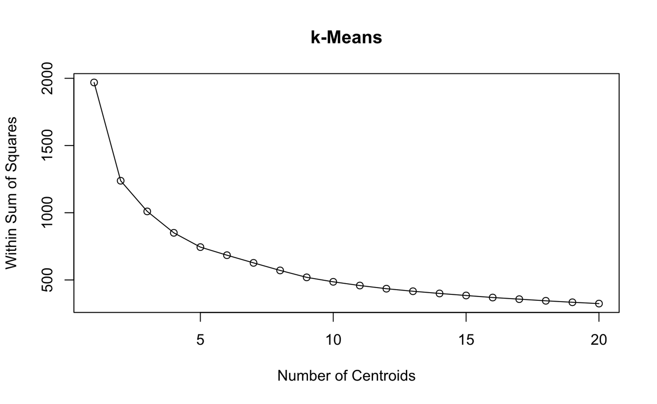
K-Means Clustering

Slide 7
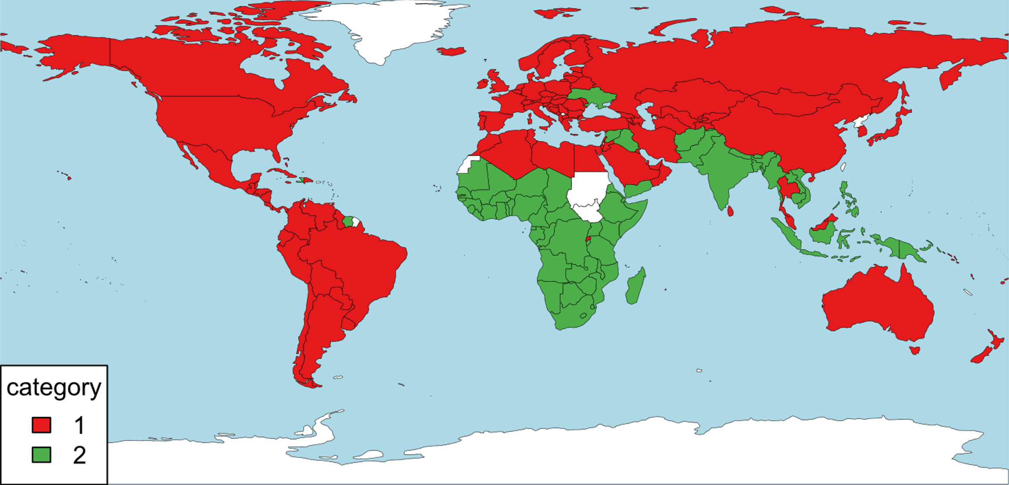
K-means clustering with 2 centroids

Slide 8
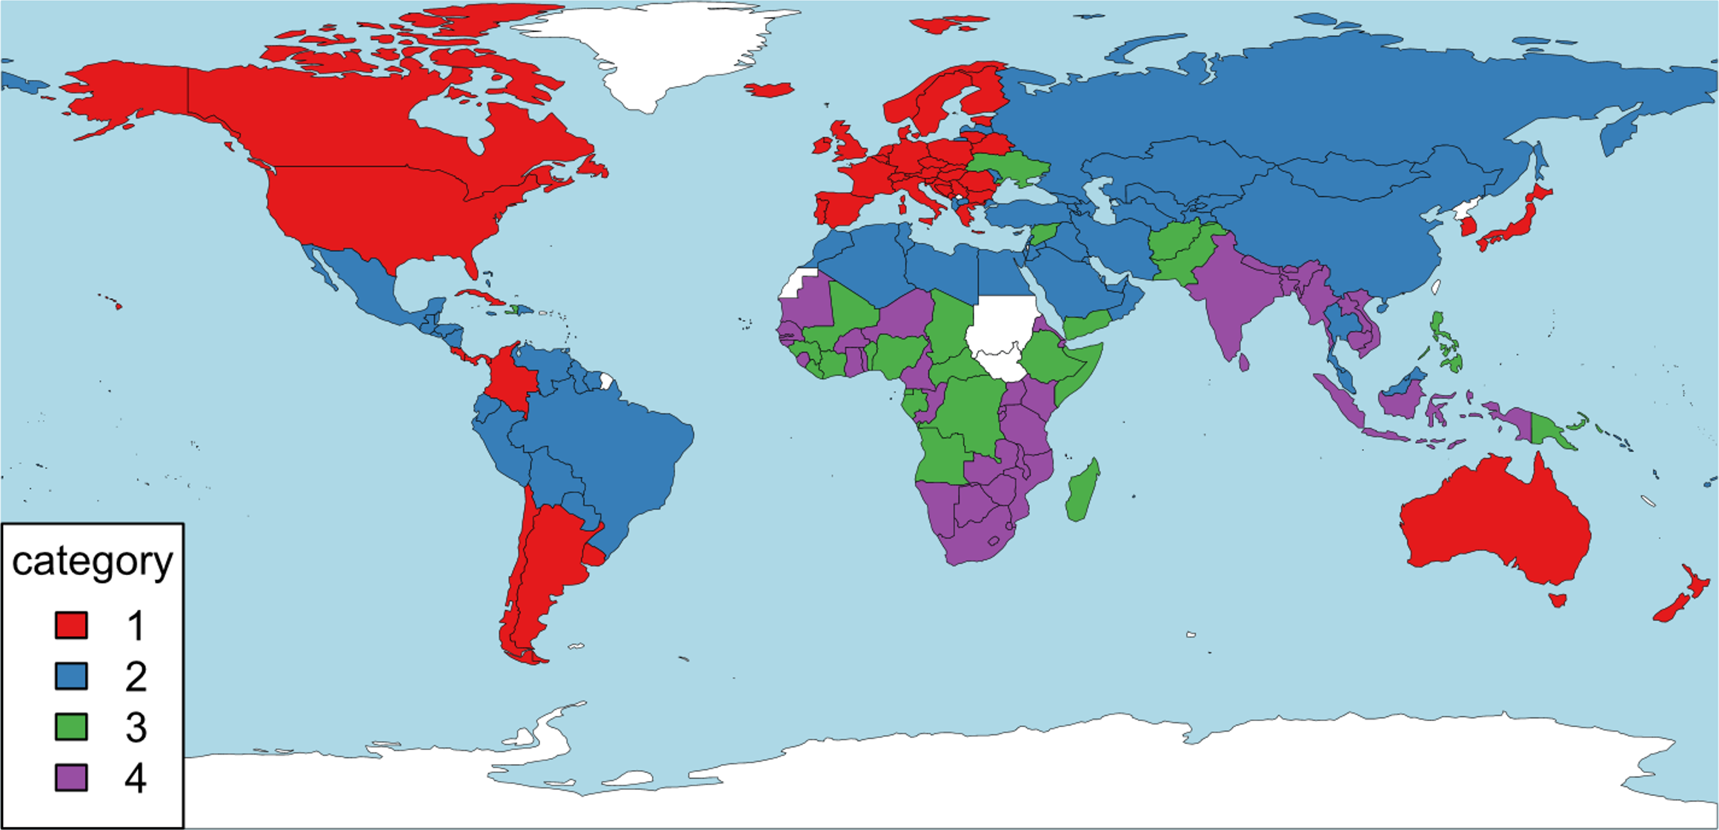
K-means clustering with 4 centroids

Slide 9
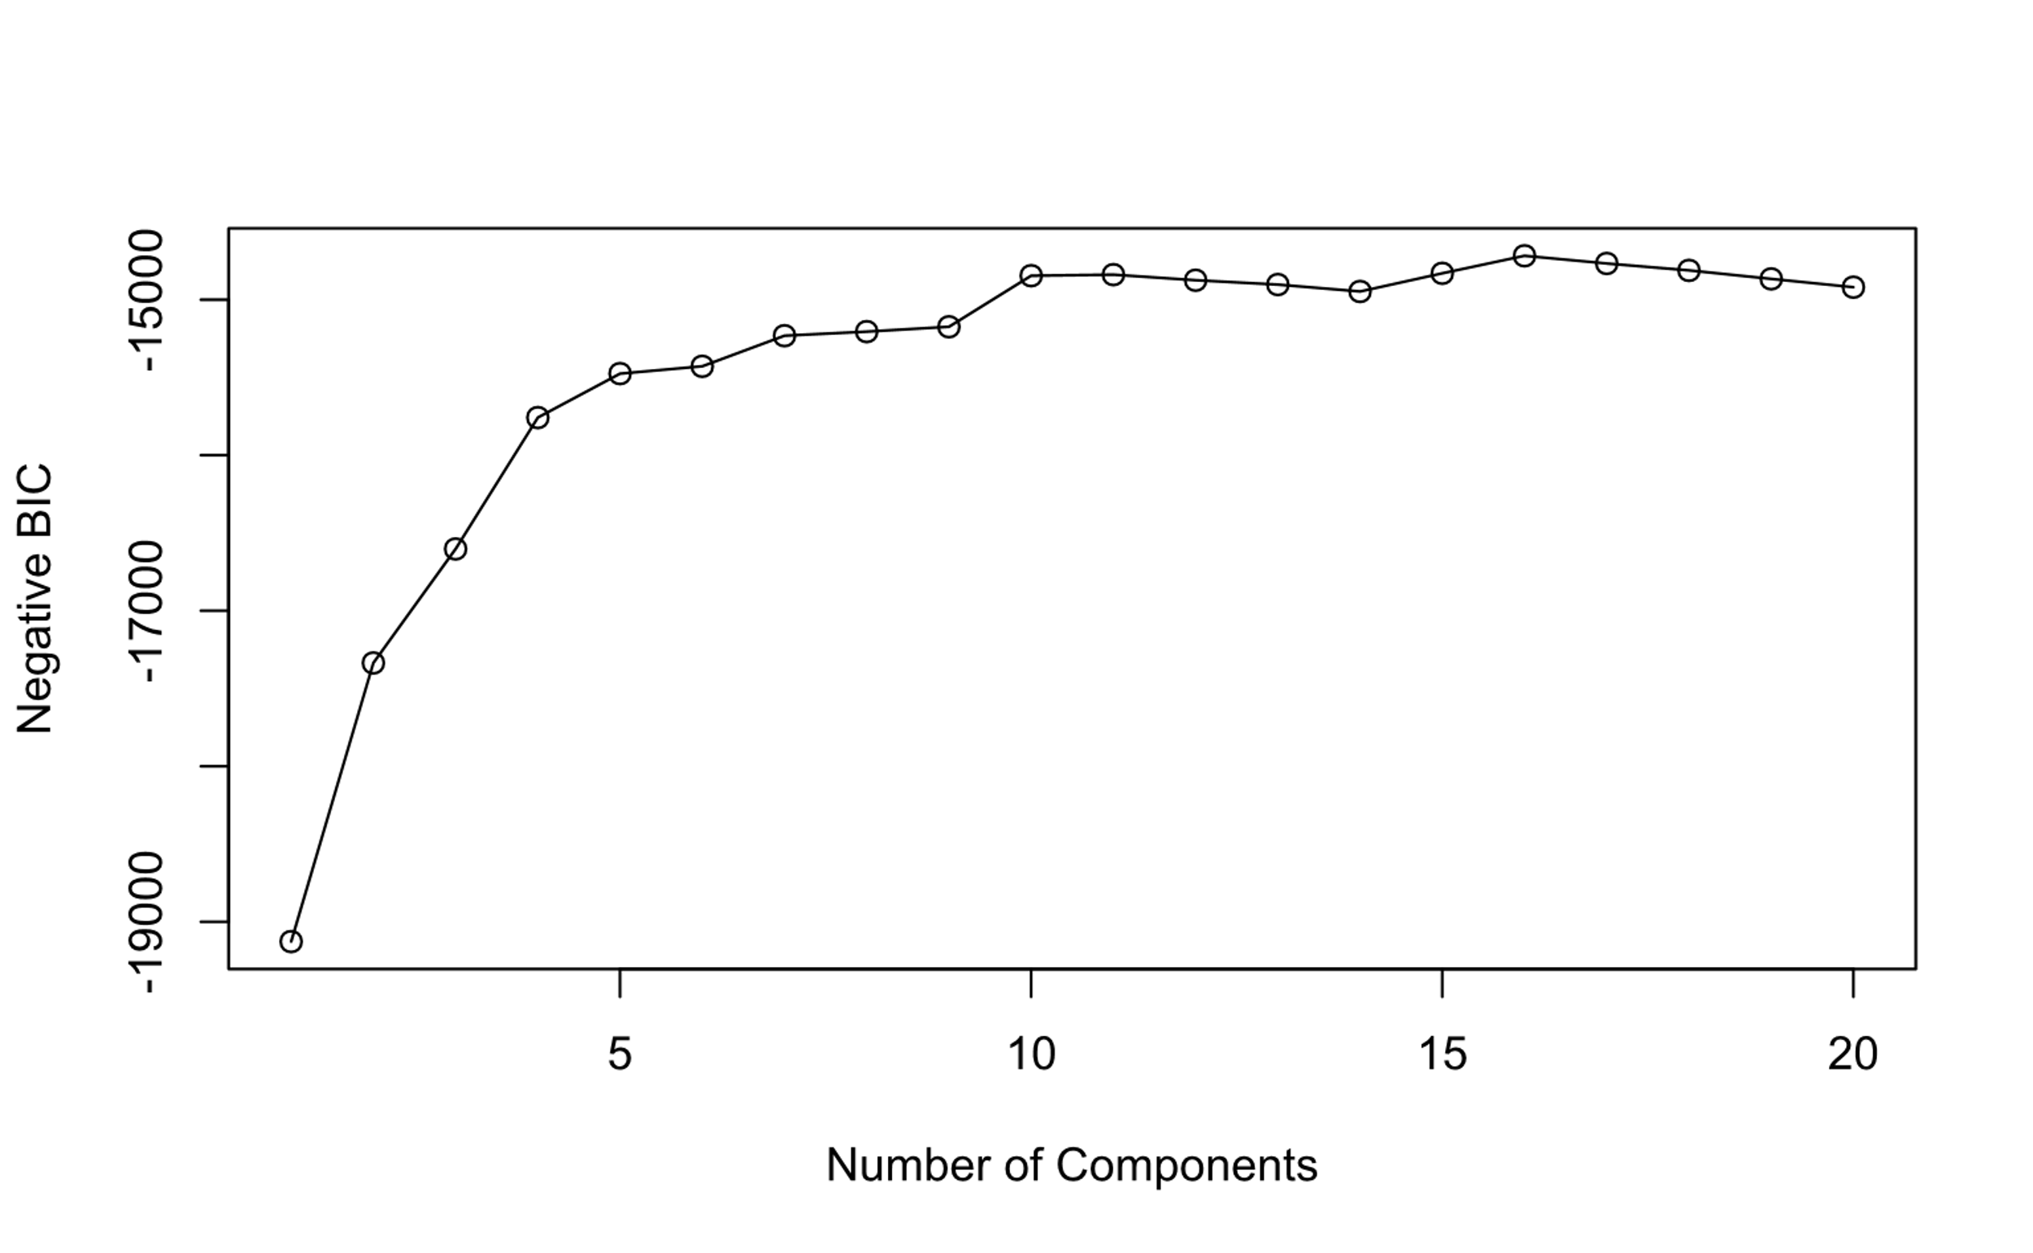
Model-Based Negative BIC

Slide 10
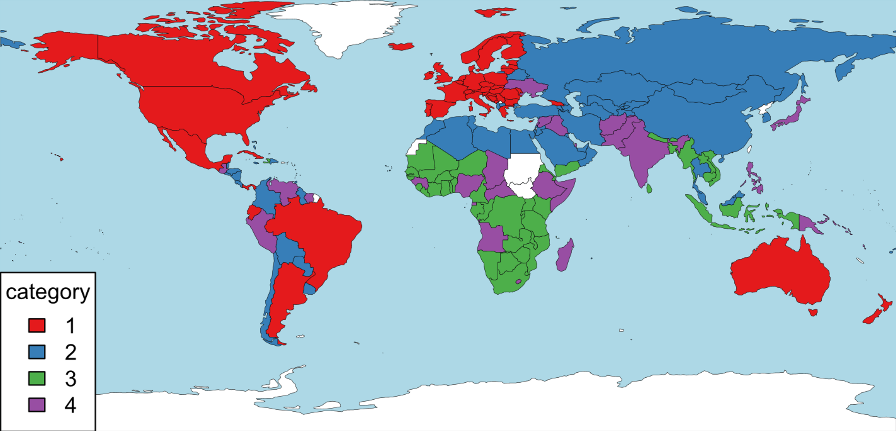
Model-based clustering with 4 components

Slide 11
K-Means vs Model-Based
K-Means
Model-Based

Slide 12
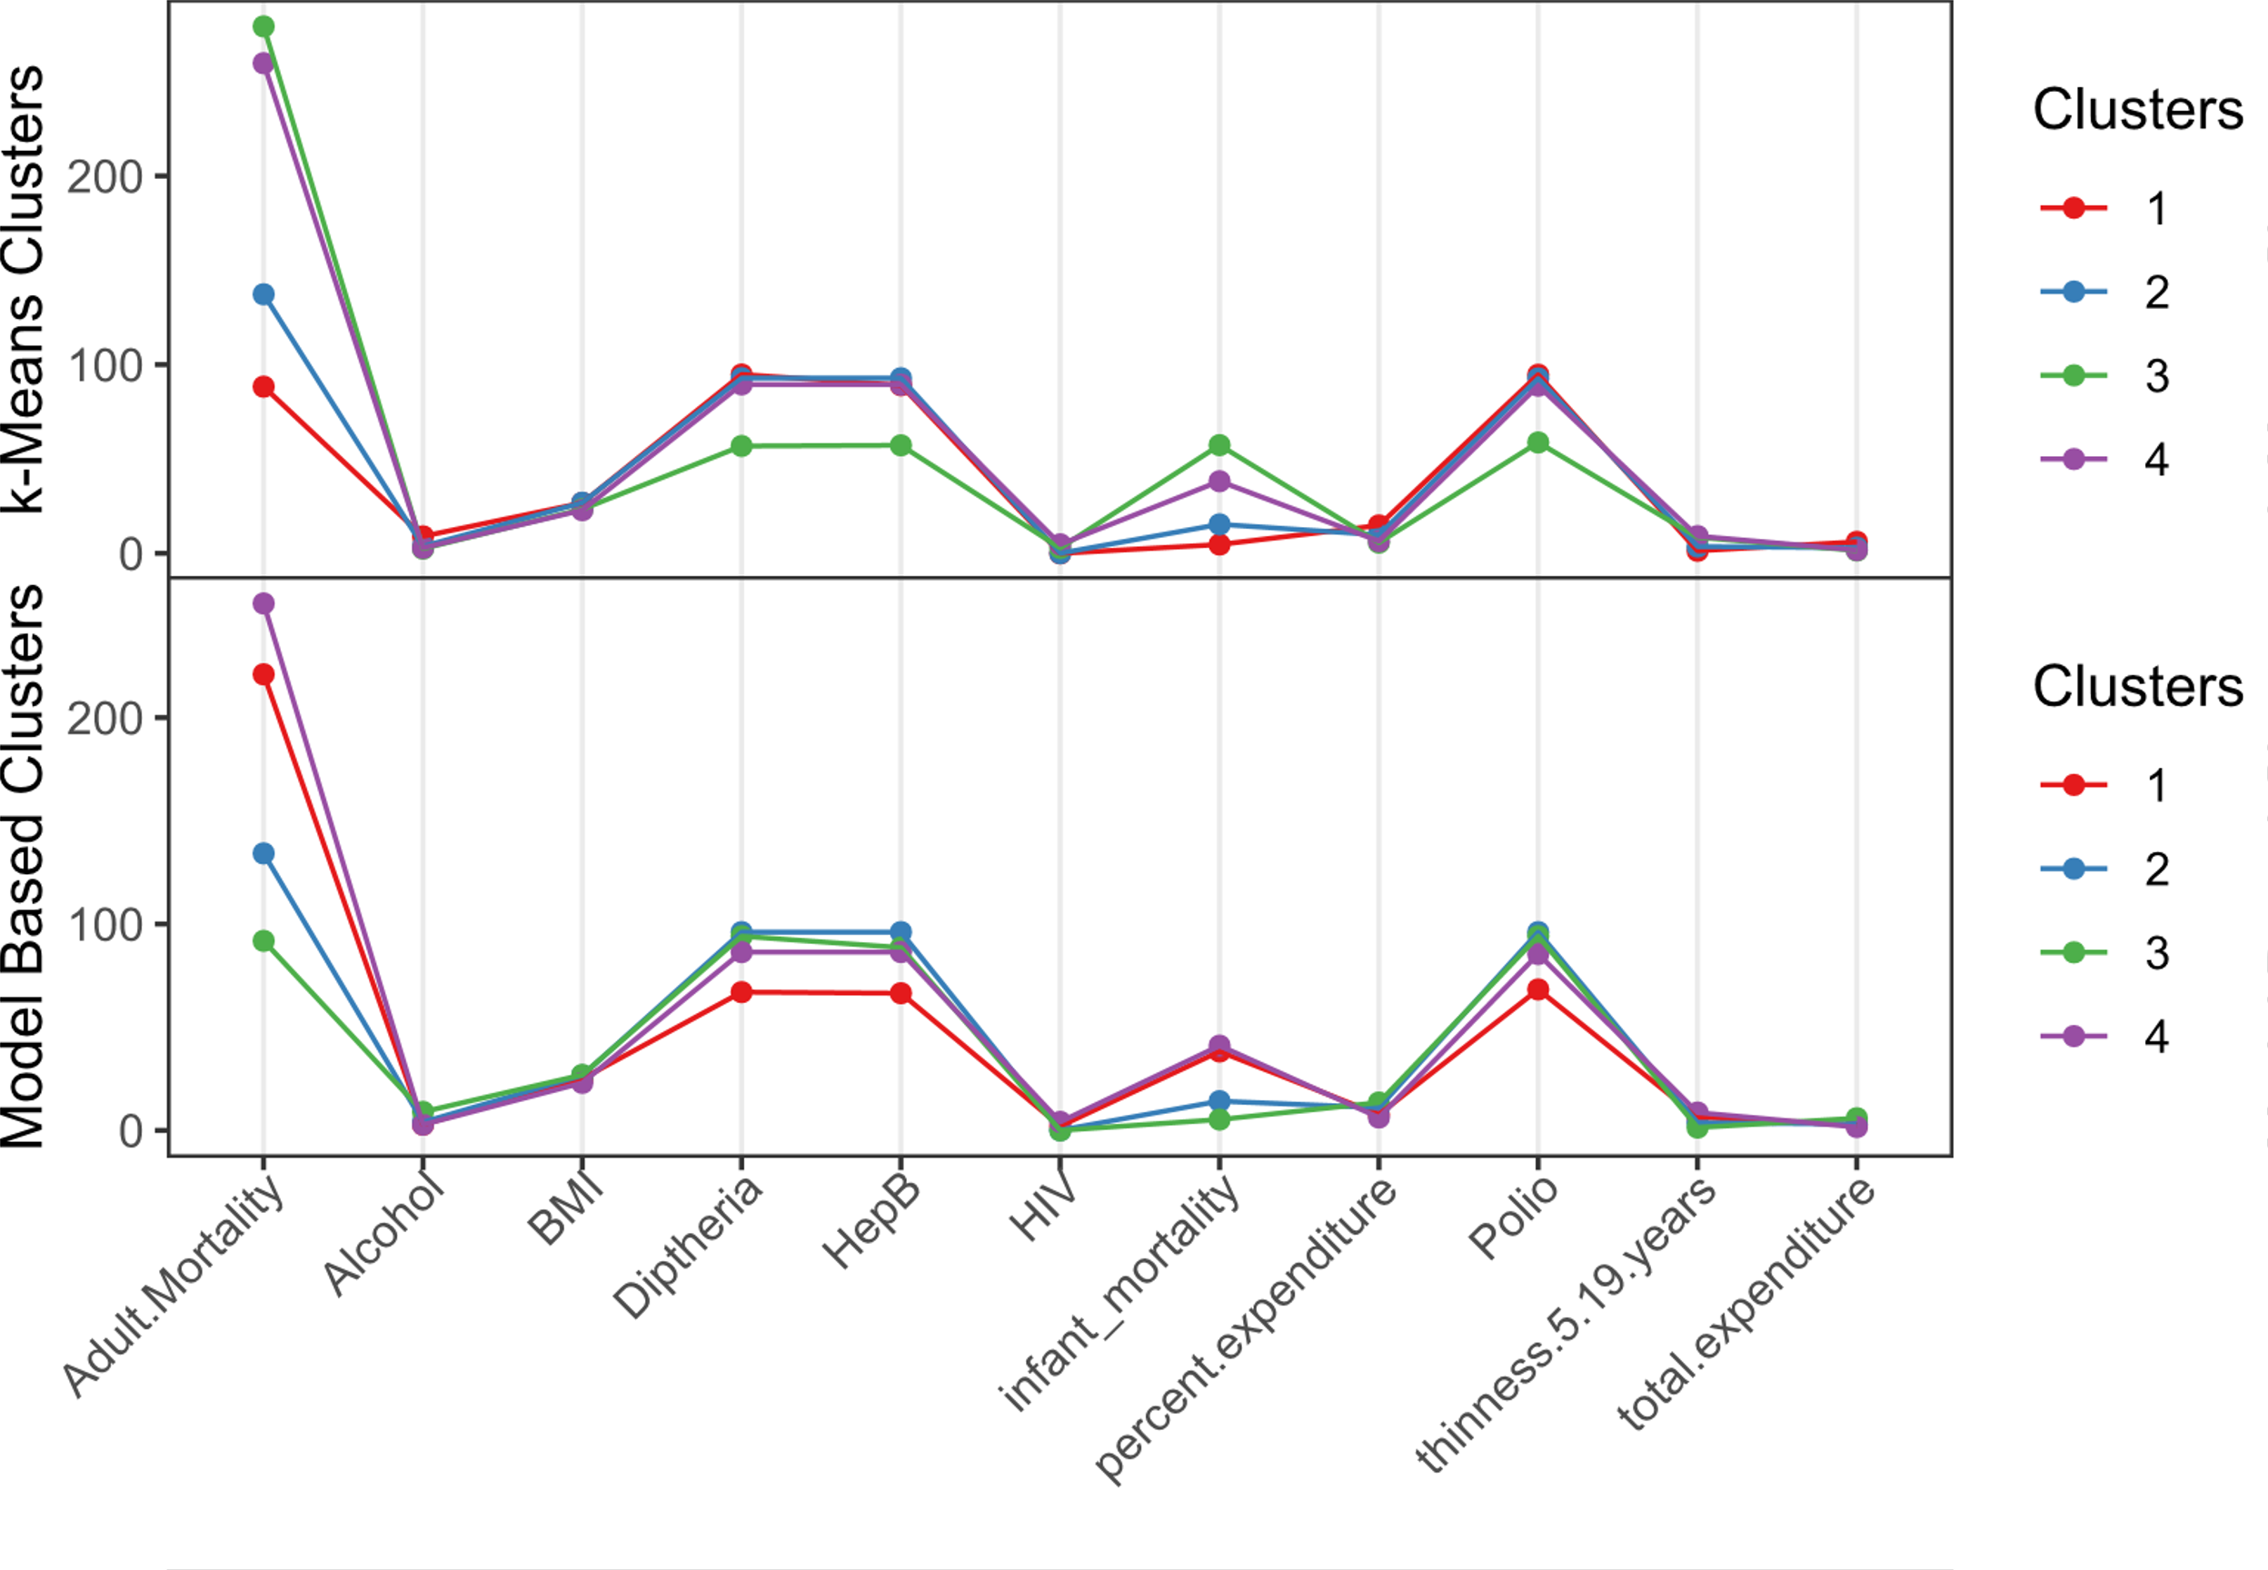
K-Means vs Model-Based

Slide 13
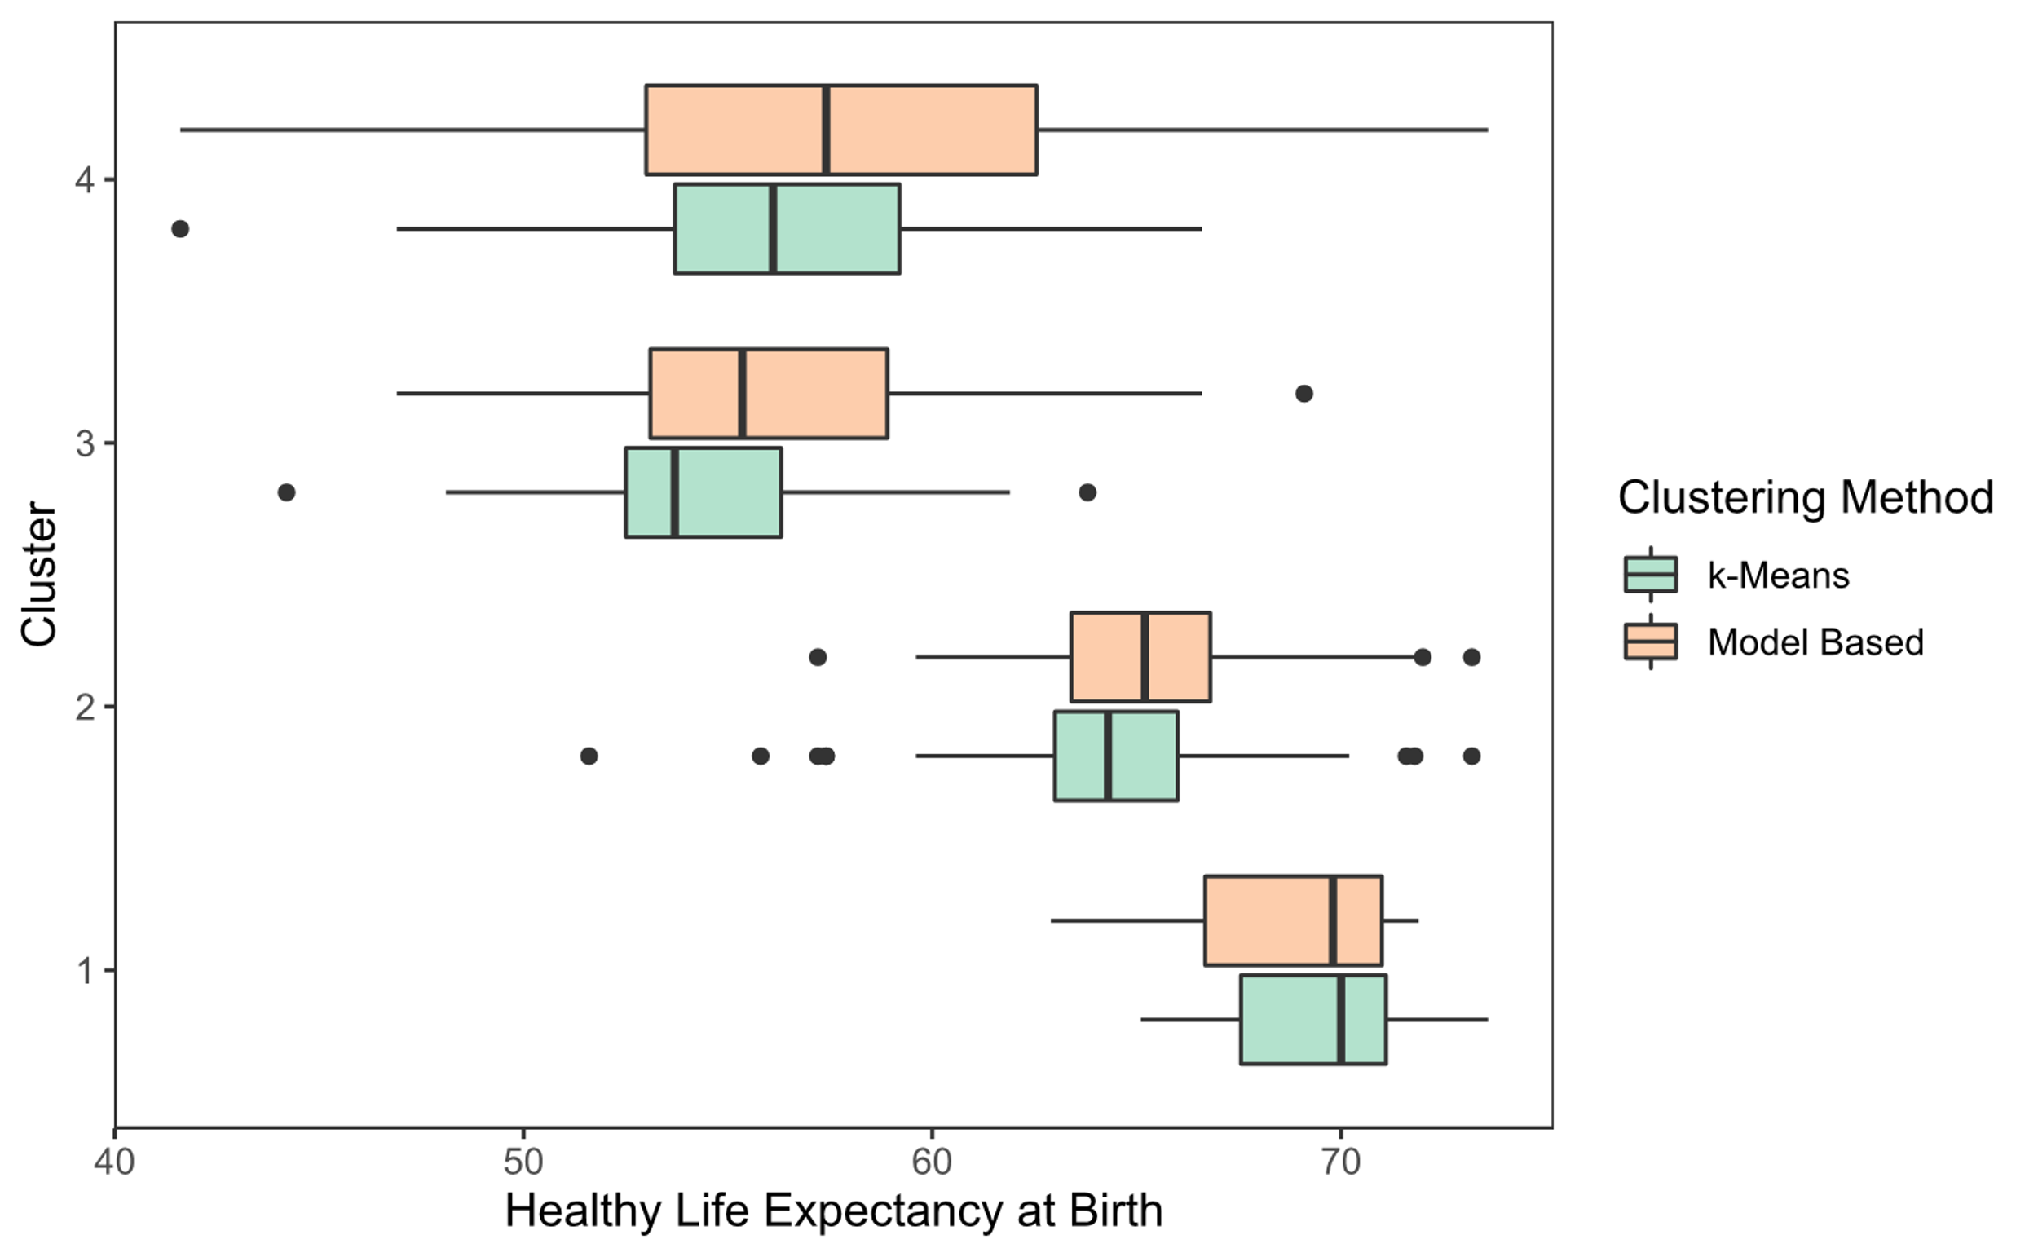
K-Means vs Model-Based

Slide 14
Random Forest
Variable Importance Results
Rank | Cluster1 | Cluster 2 | Cluster 3 | Cluster 4
1 | Adult Mortality | Infant Mortality | Infant Mortality | Adult Mortality
2 | Thinness (5-19) | Adult Mortality | Adult Mortality | HIV
3 | Percent Expenditure | Thinness (5-19) | HIV | Infant Mortality
4 | BMI | Total Expenditure | Hepatitis B | Thinness (5-19)
5 | Infant Mortality | Diphtheria | Diphtheria | Total Expenditure
6 | Alcohol | BMI | Percent Expenditure | Percent Expenditure
7 | Total Expenditure | Polio | Alcohol | Polio
8 | Hepatitis B | Alcohol | BMI | BMI
9 | Polio | Percent Expenditure | Polio | Hepatitis B
10 | Diphtheria | Hepatitis B | Total Expenditure | Diphtheria
11 | HIV | HIV | Thinness (5-19) | Alcohol

Slide 15
Regression
Variables Dropped with Lasso Regression
Cluster 1 | Cluster 2 | Cluster 3 | Cluster 4
Diphtheria | Diphtheria | BMI | Diphtheria
 | BMI | Polio | log(Alcohol)
 | (Hepatitis B)­­⁵ | log(Percent Expenditure) | Polio
 |  | Thinness (5-19) | Thinness (5-19)
 |  |  | Total Expenditure

Slide 16
Regression
Significant Variables After Linear Regression
Cluster 1 | Cluster 2 | Cluster 3 | Cluster 4
Adult Mortality | Adult Mortality | log(Infant Mortality) | Adult Mortality
BMI | log(Infant Mortality) |  | HIV
log(Percent Expenditure) | log(Percent Expenditure)
Total Expenditure | log(Alcohol)
Thinness (5-19)
Polio

Slide 17
UNDERPRIVILEGED COUNTRIES : HIV,MALNUTRITION AMONG CHILDREN, HEPATITIS B ETC.
CONCLUSIONS
COUNTRIES WITH STRONG SOCIO-ECONOMIC CONDTIONS: percentage expenditure, BMI, ​ALCOHOL ETC.
PREDICTIONS BASED ON 2014 DATA
​

